Slide 1
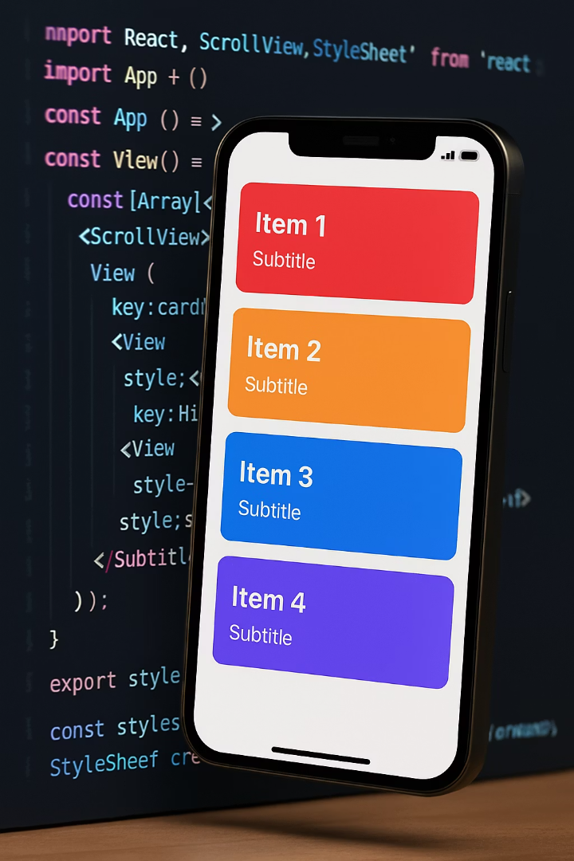

React Native List Components
Welcome to this comprehensive guide on FlatList and SectionList components in React Native. These powerful tools are essential for building efficient, performant mobile UIs.
We'll explore implementation techniques for smooth scrolling experiences including pull-to-refresh and infinite scrolling.

Slide 2
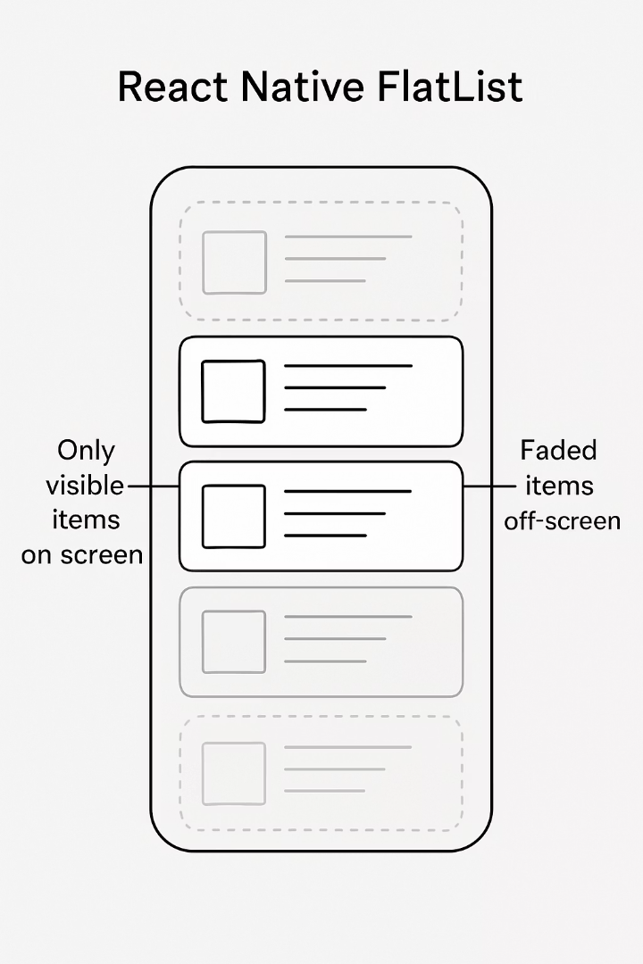
FlatList: High-Performance List View
Optimized Performance
Smart Rendering
Uses virtualization to render only items currently visible on screen, saving memory.
Designed specifically for large, scrollable data sets that may contain thousands of items.
Flexible Implementation
Supports lazy loading patterns and highly customizable layouts for various applications.

Slide 3




FlatList: Key Features
Dynamic Rendering
Renders items via renderItem prop, allowing complete control over item appearance.
Memory Efficient
Optimized memory usage even with large datasets through virtualization.
Flexible Data
Supports dynamic data updates and smooth reordering with minimal configuration.

Slide 4
FlatList: Basic Usage Example
const styles = StyleSheet.create({
container: {
flex: 1,
marginTop: 50,
},
item: {
backgroundColor: '#f9c2ff',
padding: 20,
marginVertical: 8,
marginHorizontal: 16,
borderRadius: 5,
},
title: {
fontSize: 18,
},
});
import React from 'react';
import { View, Text, FlatList, StyleSheet } from 'react-native';
const DATA = [
{ id: '1', title: 'Apple' },
{ id: '2', title: 'Banana' },
{ id: '3', title: 'Cherry' },
{ id: '4', title: 'Date' },
{ id: '5', title: 'Elderberry' },
];
const Item = ({ title }) => (
<View style={styles.item}>
<Text style={styles.title}>{title}</Text>
</View>
);
const App = () => {
return (
<View style={styles.container}>
<FlatList
data={DATA}
renderItem={({ item }) => <Item title={item.title} />}
keyExtractor={item => item.id}
/>
</View>
);
};
export default App;
This example demonstrates the three required props: data (array of items), renderItem (how each item looks), and keyExtractor (unique identifier).

Slide 5
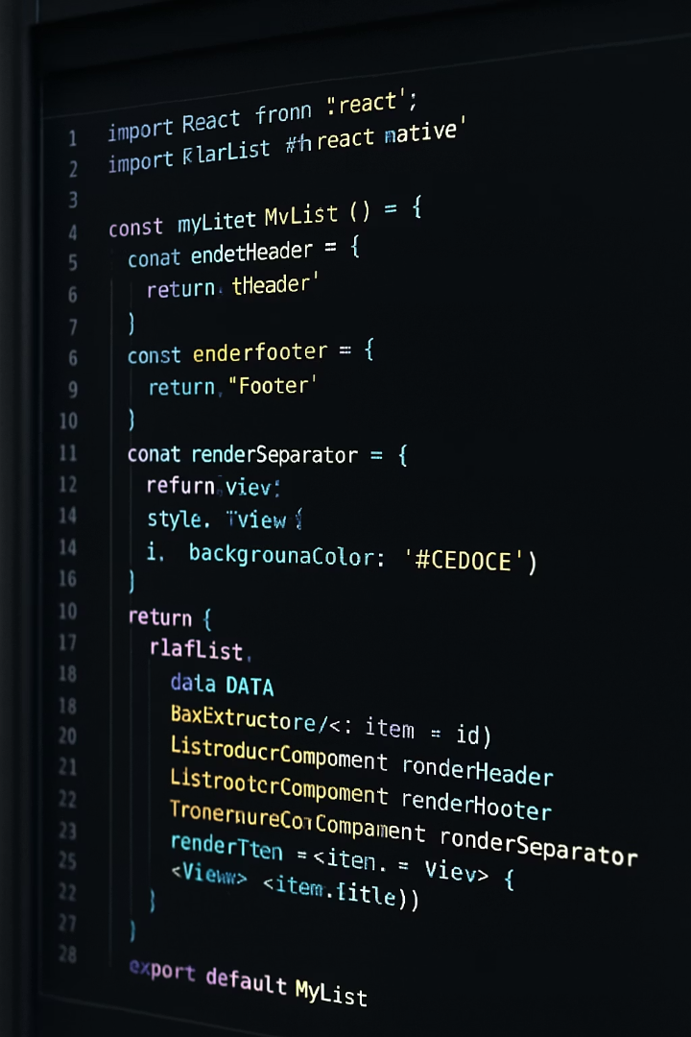




Advanced FlatList Props
Performance Controls
Fine-tune rendering with initialNumToRender and windowSize props to control how many items load initially.
Layout Components
Add ListHeaderComponent and ListFooterComponent for consistent header and footer elements.
Visual Separation
Implement ItemSeparatorComponent to add dividers between list items for better visual hierarchy.
Responsive Design
Utilize numColumns prop to create grid layouts that adapt to different screen sizes.

Slide 6
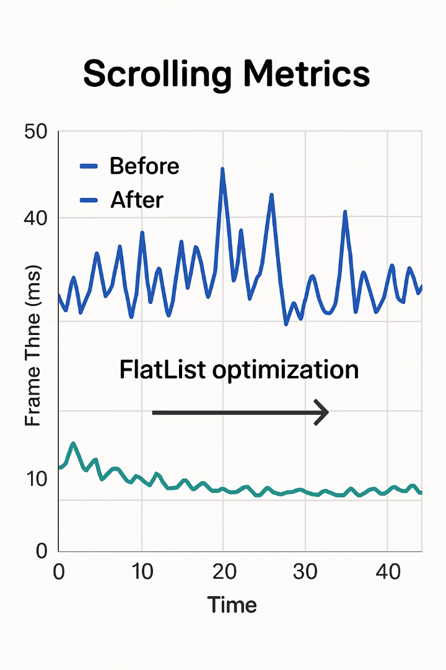
Optimizing FlatList Performance
Use Stable Keys
Implement keyExtractor to provide consistent, unique identifiers for each item. This prevents unnecessary re-renders.
keyExtractor={item => item.id.toString()}
Memoize Components
Wrap your rendered items with React.memo to prevent unnecessary re-renders when props haven't changed.
const ItemComponent = React.memo(({title}) => (
{title}
));
Manage Updates Carefully
Use extraData prop to tell FlatList when to re-render items if they depend on external data.
extraData={selectedId}

Slide 7
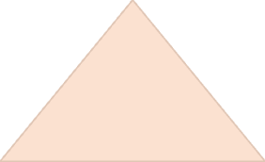





SectionList: Grouped List Rendering
Complete List Solution
Ideal for complex data organization
Section Headers
Built-in support for sticky section headers
FlatList Foundation
Built on FlatList's optimized performance
SectionList is perfect for chat applications, settings screens, and grouped catalog displays where data naturally forms distinct categories.

Slide 8
SectionList: Basic Usage Example
const styles = StyleSheet.create({
container: {
flex: 1,
marginTop: 50,
paddingHorizontal: 10,
},
header: {
fontSize: 22,
fontWeight: 'bold',
backgroundColor: '#eee',
paddingVertical: 5,
paddingHorizontal: 10,
},
item: {
fontSize: 18,
paddingVertical: 10,
paddingHorizontal: 20,
},
});
import React from 'react';
import { SectionList, Text, View, StyleSheet } from 'react-native';
const MySectionList = () => {
const DATA = [
{
title: 'Fruits',
data: ['Apple', 'Banana', 'Cherry'],
},
{
title: 'Vegetables',
data: ['Carrot', 'Broccoli', 'Spinach'],
},
];
return (
<View style={styles.container}>
<SectionList
sections={DATA}
renderItem={({ item }) => <Text style={styles.item}>{item}</Text>}
renderSectionHeader={({ section }) => (
<Text style={styles.header}>{section.title}</Text>
)}
keyExtractor={(item, index) => item + index}
/>
</View>
);
};
export default MySectionList;
This example shows the essential props: sections array, renderItem function, and renderSectionHeader function.

Slide 9
SectionList: Customizing Section Headers
Style Customization
Interactive Headers
renderSectionHeader={({ section }) => ( <View style={styles.headerContainer}> <Text style={styles.headerTitle}>{section.title}</Text> <Text style={styles.headerSubtitle}>{section.data.length} items</Text> </View> )} const styles = StyleSheet.create({ headerContainer: { backgroundColor: '#f0f0f0', paddingVertical: 10, paddingHorizontal: 16, borderBottomWidth: 1, borderBottomColor: '#ccc', }, headerTitle: { fontSize: 20, fontWeight: 'bold', color: '#333', }, headerSubtitle: { fontSize: 14, color: '#666', }, });
renderSectionHeader={({ section }) => (
<TouchableOpacity
onPress={() => toggleSection(section.title)}
style={styles.header}
>
<Text style={styles.headerText}>{section.title}</Text>
</TouchableOpacity>
)}
const styles = StyleSheet.create({
header: {
backgroundColor: '#e0e0e0',
padding: 12,
},
headerText: {
fontSize: 18,
fontWeight: 'bold',
},
});
Sticky Headers Configuration
Control the sticky behavior of section headers with prop:
stickySectionHeadersEnabled={true}

Slide 10
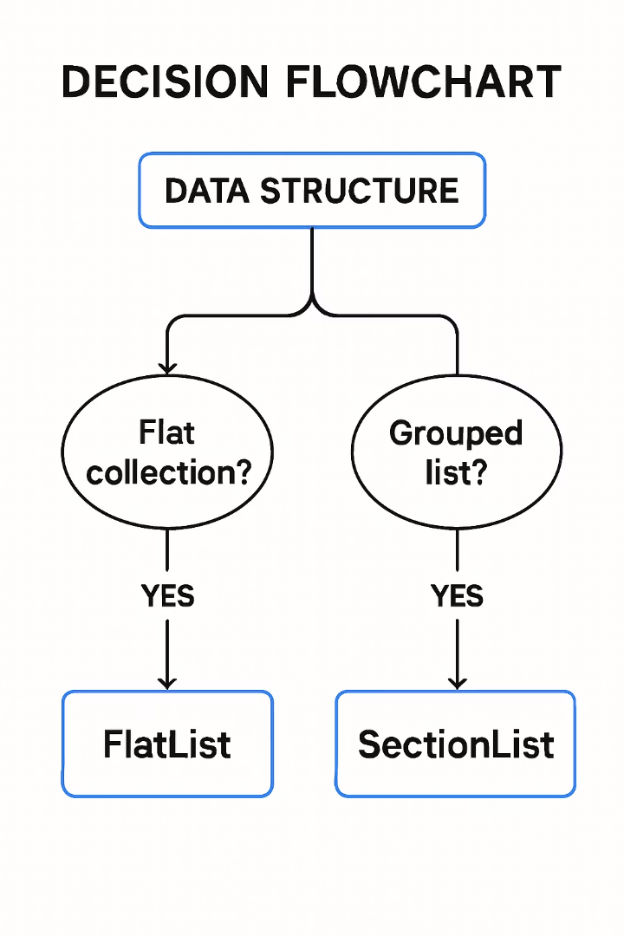




When to Use FlatList vs. SectionList
Assess Your Data
Start by analyzing your data structure. Is it flat or naturally grouped?
Check Grouping Needs
Determine if your data benefits from visual or logical grouping.
Users often scan by group in large datasets
Categories improve cognitive processing
Consider UI Patterns
Match list type to common patterns in similar apps.
FlatList: Social feeds, search results
SectionList: Settings, contacts, categorized items
Make Your Decision
Choose FlatList for uniform, ungrouped data. Select SectionList for categorized information.

Slide 11
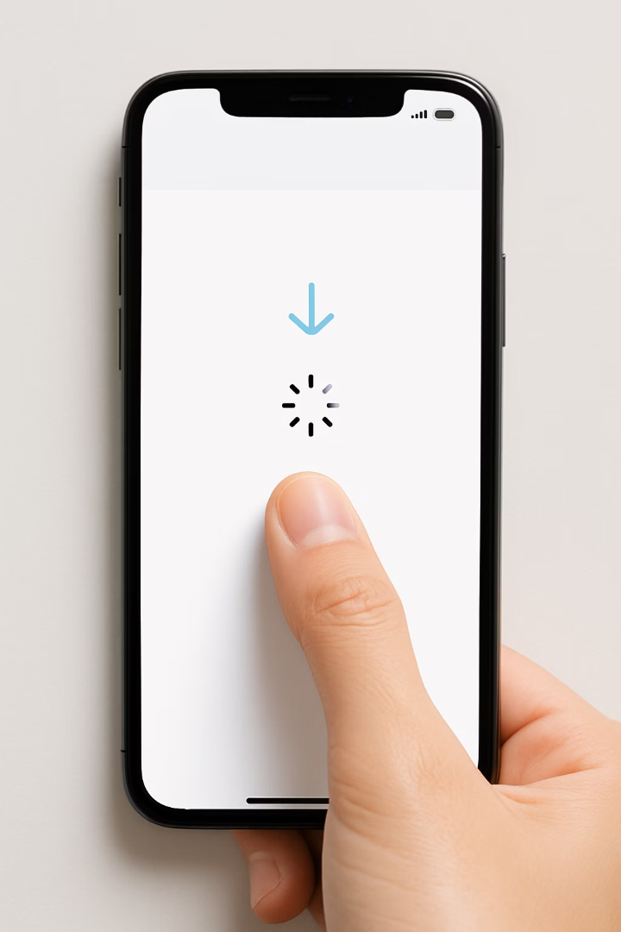




Introduction to Pull-to-Refresh
Origin
Introduced with iOS 6 in 2012, pull-to-refresh quickly became an industry standard gesture.
User Preference
Research shows 92% of users prefer apps with manual refresh options.
Modern Standard
Now expected in most mobile apps with dynamic content.
React Native Support
Built directly into FlatList and SectionList components.
Pull-to-refresh has become the most intuitive way for users to manually update content in mobile applications.

Slide 12








Enabling Pull-to-Refresh in FlatList
Simple Implementation
Minimal Code
FlatList provides built-in support via refreshing and onRefresh props.
Only requires state management and a refresh function.
User Experience
Popular Use Cases
92% of users prefer having manual refresh options in apps.
Essential for news feeds, social media, and content-heavy apps.
Pull-to-refresh gives users control over content updates while maintaining a clean interface without permanent refresh buttons.

Slide 13
Pull-to-Refresh: FlatList Implementation Example
import React, { useState } from 'react';
import { FlatList, Text, View, StyleSheet } from 'react-native';
const initialData = [
{ id: '1', title: 'First Item' },
{ id: '2', title: 'Second Item' },
{ id: '3', title: 'Third Item' },
];
const fetchNewData = () => {
return new Promise(resolve => {
setTimeout(() => {
resolve([
{ id: '4', title: 'New Item 1' },
{ id: '5', title: 'New Item 2' }
]);
}, 2000); // Simulate network delay
});
};
const RefreshableList = () => {
const [refreshing, setRefreshing] = useState(false);
const [data, setData] = useState(initialData);
const onRefresh = React.useCallback(() => {
setRefreshing(true);
fetchNewData().then(newData => {
setData(newData);
setRefreshing(false);
});
}, []);
return (
<FlatList
data={data}
renderItem={({ item }) => (
<View style={styles.itemContainer}>
<Text style={styles.itemText}>{item.title}</Text>
</View>
)}
keyExtractor={item => item.id}
refreshing={refreshing}
onRefresh={onRefresh}
/>
);
};
export default RefreshableList;
const styles = StyleSheet.create({
itemContainer: {
padding: 16,
borderBottomWidth: 1,
borderBottomColor: '#ccc',
},
itemText: {
fontSize: 18,
},
});
This example demonstrates managing refresh state and handling the data fetch when the user pulls to refresh.

Slide 14



Pull-to-Refresh in SectionList
Identical API
SectionList supports the same refreshing and onRefresh props as FlatList
Section Handling
Update section data structure when new content arrives
Data Merging
Carefully merge or update sectioned data to maintain grouping

Slide 15

Best Practices for Pull-to-Refresh
Clear Loading Indicators
Always show a spinner while loading
Position indicator at the top of the list
Use consistent animation styles
Manage Refresh Frequency
Implement debouncing to prevent excessive API calls
Consider adding a minimum time between refreshes
Cache results when appropriate
Provide User Feedback
Show toast message if no new data is available
Animate new items when they appear
Handle errors gracefully with feedback
Maintain Performance
Keep refresh operations lightweight
Consider pagination for large datasets
Optimize network requests

Slide 16





Introduction to Infinite Scrolling
Seamless Content Loading
Automatically loads new items as the user scrolls to the bottom of the list.
Industry Standard
Used by Netflix, Instagram, Twitter and most content-heavy platforms.
Improved Engagement
Keeps users engaged by reducing manual interaction needed to see more content.
Performance Benefits
Loads content in manageable chunks, improving overall app performance.
Infinite scrolling creates a frictionless experience that encourages continued browsing and discovery.

Slide 17








Infinite Scrolling in FlatList
User Scrolls Down
Threshold Reached
User approaches the end of currently loaded content
onEndReached triggered when threshold is crossed
List Updated
Data Fetched
New items appended to existing list data
New data is requested from API or local storage
The key prop is onEndReached, which fires when the user approaches the end of the list. Use onEndReachedThreshold to control when this triggers (e.g., 0.5 = halfway).

Slide 18
Implementing Infinite Scroll: FlatList Example
import React, { useState, useEffect } from 'react';
import { FlatList, Text, View, StyleSheet, ActivityIndicator } from 'react-native';
const fetchMoreData = (page) => {
return new Promise(resolve => {
setTimeout(() => {
const moreData = Array.from({ length: 10 }, (_, i) => ({
id: String(page * 10 + i),
title: `Item ${page * 10 + i}`,
}));
resolve(moreData);
}, 1500); // Simulate network delay
});
};
const styles = StyleSheet.create({
item: {
padding: 16,
borderBottomWidth: 1,
borderColor: '#ddd',
},
title: {
fontSize: 16,
},
});
const InfiniteScrollList = () => {
const [data, setData] = useState([]);
const [page, setPage] = useState(0);
const [loading, setLoading] = useState(false);
const [hasMore, setHasMore] = useState(true);
const loadMore = async () => {
if (loading || !hasMore) return;
setLoading(true);
const newData = await fetchMoreData(page + 1);
if (newData.length === 0) {
setHasMore(false); // No more data to load
} else {
setData(prev => [...prev, ...newData]);
setPage(prev => prev + 1);
}
setLoading(false);
};
useEffect(() => {
loadMore(); // Initial load
}, []);
//Return FlatList in next slides
};
export default InfiniteScrollList;

Slide 19
return (
<FlatList
data={data}
renderItem={({ item }) => (
<View style={styles.item}>
<Text style={styles.title}>{item.title}</Text>
</View>
)}
keyExtractor={item => item.id}
onEndReached={loadMore}
onEndReachedThreshold={0.5}
ListFooterComponent={
loading && hasMore ? (
<ActivityIndicator style={{ marginVertical: 20 }} />
) : null
}
/>
);

Slide 20
Infinite Scrolling in SectionList
Similar Implementation
Section-Specific Challenges
Real-World Applications
SectionList uses the same onEndReached and onEndReachedThreshold props as FlatList.
Managing sectioned data requires special handling when appending new content.
Perfect for chat history, message logs, and chronological grouped content.
May need to merge with existing sections
Example: WhatsApp loads older message groups as you scroll up through chat history.
Handle pagination for each section
Maintain section order while adding new data

Slide 21

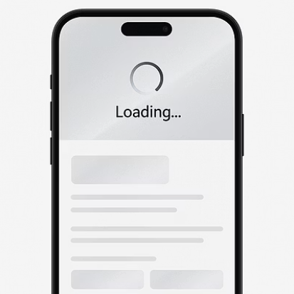
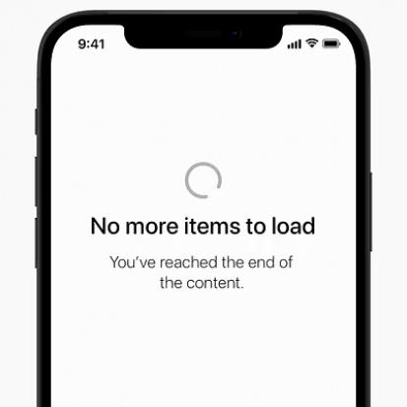
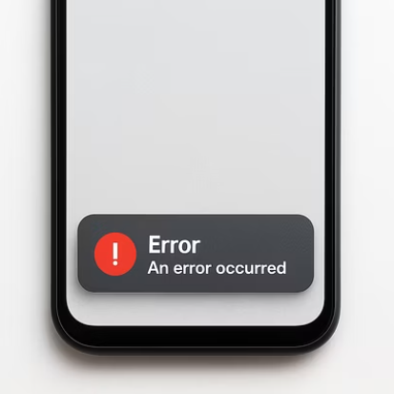
Error Handling and Edge Cases
Display Error States
Network Handling
Prevent Race Conditions
Show friendly error messages when fetches fail
Implement timeout and retry logic
Use loading flags to prevent duplicate fetches
Cache data for offline access
Provide clear retry options
Resume loading when connection returns
Cancel pending requests when appropriate
Consider inline vs. full-screen errors
Implement proper request queuing

Slide 22
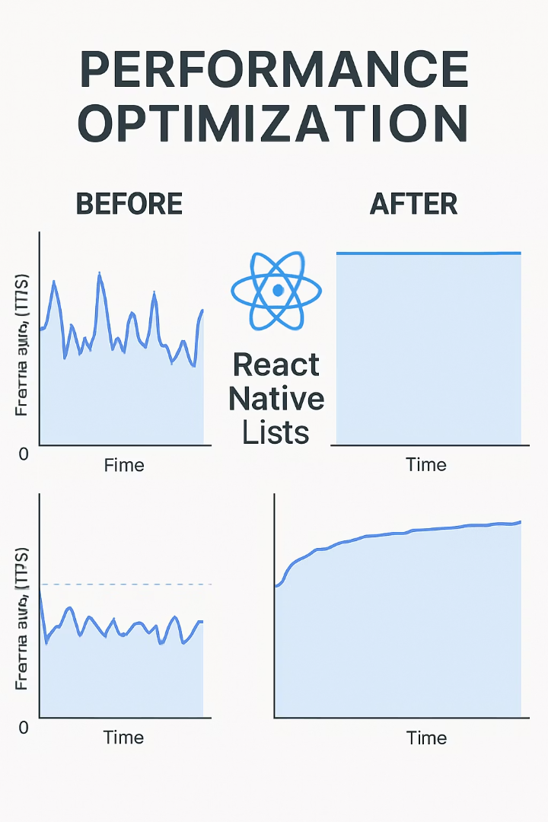
Performance Pitfalls and Solutions
Common Issue
Solution
Impact
Missing or duplicate keys
Implement proper keyExtractor
Prevents unnecessary re-renders
Bloated render items
Use React.memo and PureComponent
Reduces render time by 40-60%
Complex item layouts
Simplify, flatten component tree
Improves scroll performance
Large images
Optimize, lazy load, use thumbnails
Reduces memory usage
Non-optimized list settings
Tune initialNumToRender, windowSize
Better initial load time
JavaScript thread blocking
Move heavy work to separate threads
Prevents UI jank
Performance optimization is critical for scroll-heavy interfaces. Even small improvements compound to create a significantly better user experience.

Slide 23




Summary: Best Practices Checklist
Core List Implementation
Use stable, unique keys via keyExtractor
Memoize item components with React.memo
Set appropriate initialNumToRender (8-10 items)
Implement getItemLayout when possible
Pull-to-Refresh Features
Show clear loading indicators
Implement debouncing to prevent excessive refreshes
Provide feedback when no new data is available
Handle errors gracefully with retry options
Infinite Scrolling
Set appropriate onEndReachedThreshold (0.3-0.5)
Prevent duplicate fetches with loading flags
Add visible loading indicators at list bottom
Implement pagination with proper page tracking
Performance Optimization
Flatten component trees in list items
Optimize images with caching and resizing
Use windowSize to control render ahead/behind
Profile and monitor frame rates regularly

Slide 24
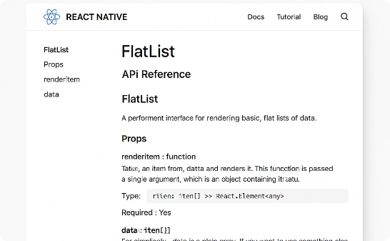
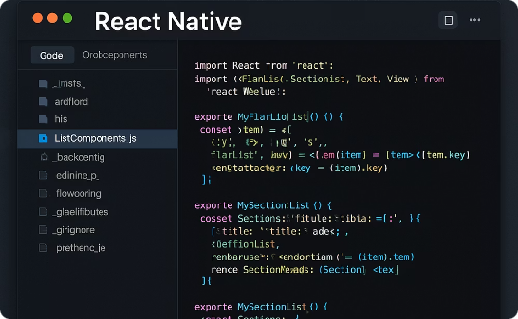

Conclusion & Resources
Official Documentation
Code Examples
Video Tutorials
The React Native docs provide comprehensive API references for FlatList and SectionList.
Find practical examples on GitHub and open source projects.
Visual learners can find step-by-step tutorials on YouTube and course platforms.
We've covered FlatList, SectionList, pull-to-refresh and infinite scrolling. These powerful tools will help you create performant, user-friendly list experiences in your React Native apps.

